Slide 2

Financial Analysis & Modelling
Cost & Management Accounting - III
Best wishes
Dr R Narayanaswamy

Slide 3
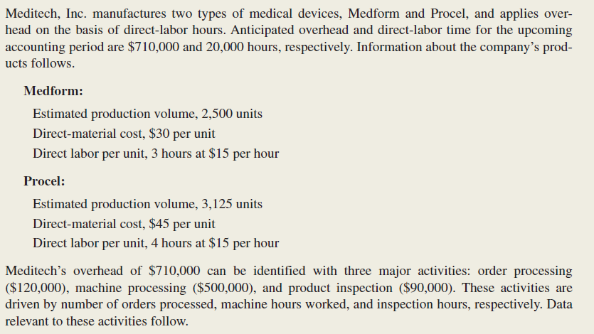
ABC – One
+ 91 98452 87646 Dr R. Narayanaswamy lecswamy@gmail.com
Notes:
www.swamyspfa.in

Slide 4
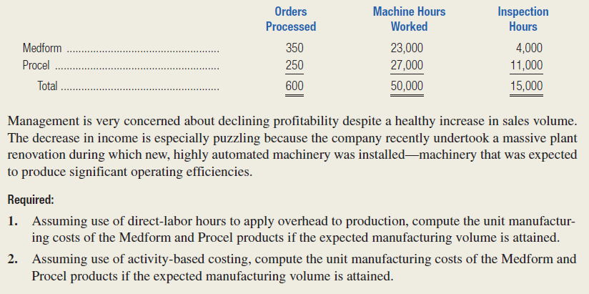
ABC - One
+ 91 98452 87646 Dr R. Narayanaswamy lecswamy@gmail.com
Notes:
www.swamyspfa.in

Slide 5
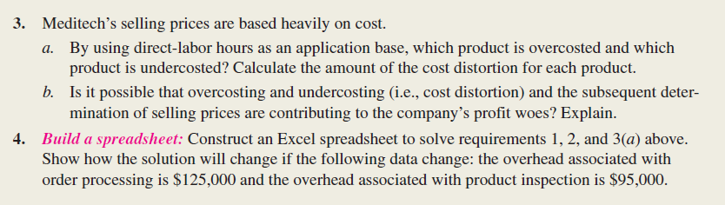
ABC - One
+ 91 98452 87646 Dr R. Narayanaswamy lecswamy@gmail.com
Notes:
www.swamyspfa.in

Slide 6
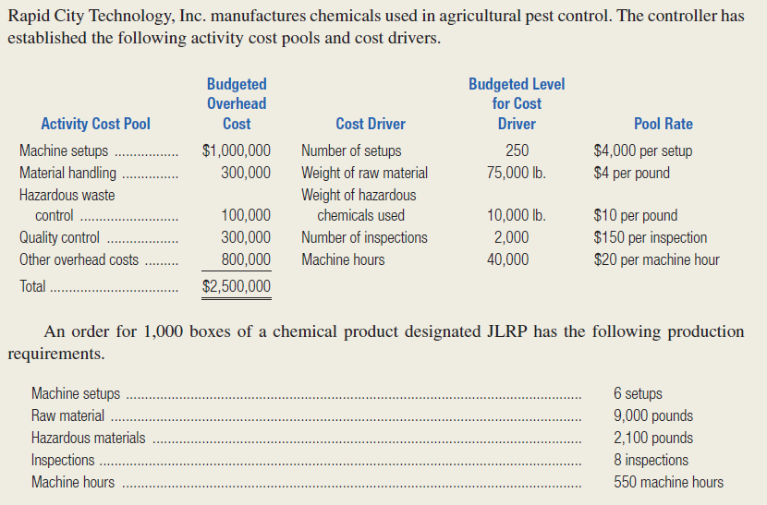
ABC - Two
+ 91 98452 87646 Dr R. Narayanaswamy lecswamy@gmail.com
Notes:
www.swamyspfa.in

Slide 7
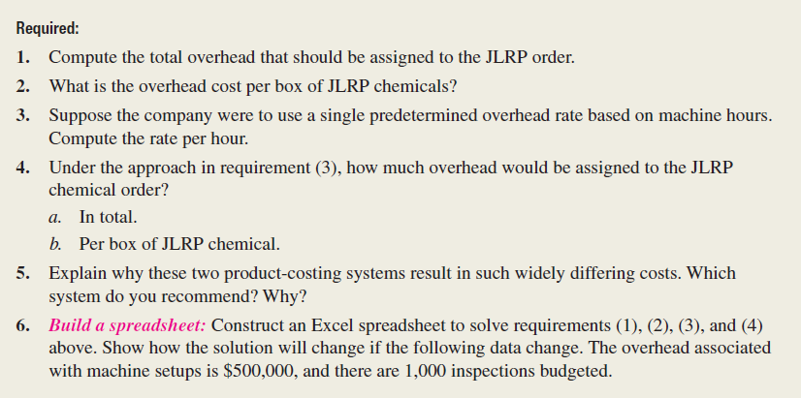
ABC – Two
+ 91 98452 87646 Dr R. Narayanaswamy lecswamy@gmail.com
Notes:
www.swamyspfa.in

Slide 8
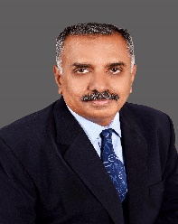
Happy Learning
Best wishes
+ 91 98452 87646 Dr R. Narayanaswamy lecswamy@gmail.com
Notes:
www.swamyspfa.blogspot.in

